Slide 1
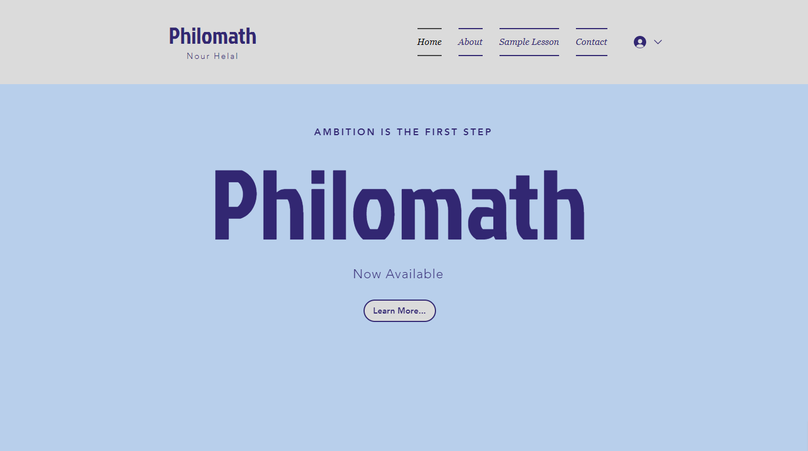

.
1
1
2
2
3
3
4
4
5
5

Slide 2

.
Solve for X:
1
1
$$4x+2=10$$
2
2
3
3
4
4
5
5

Slide 3
1
.
Solve for X:
1
1
$$4x+2=10$$
2
2
3
3
2
4
4
5
5

Slide 4

2
.
Solve for X:
1
1
$$4x+2=10$$
2
2
3
$$4x+2=10$$
$$÷4 ÷4$$
$$x+2=2.5$$
$$−2 −2$$
$$x=0.5$$
3
4
4
5
5

Slide 5

3
.
Solve for X:
1
1
$$4x+2=10$$
2
2
3
$$4x+2=10$$
$$+2 +2$$
$$4x=12$$
$$×4 ×4$$
$$x=48$$
3
4
4
5
5

Slide 6

4
.
Solve for X:
1
1
$$4x+2=10$$
2
2
3
$$4x+5=10$$
$$−5 −5$$
$$4x=5$$
$$÷4 ÷4$$
$$x=1.25$$
3
4
4
5
5

Slide 7

5
.
Solve for X:
1
1
$$4x+2=10$$
2
2
3
$$4x+2=10$$
$$−2 −2$$
$$4x=8$$
$$÷4 ÷4$$
$$x=2$$
3
4
4
5
5

Slide 8

1+
.
Technically, this is the correct answer, but if you were to write this answer bald in the exam, you will not receive the full credits.
Try again, but show your working!
Solve for X:
1
1
$$4x+2=10$$
2
2
3
3
4
2
4
5
5

Slide 9

2+
.
Sadly, this is an incorrect answer.
Sadly, this is an incorrect answer. You did not follow inverse BIDMAS.
Try again following the rules of inverse BIDMAS!
Solve for X:
1
1
$$4x+2=10$$
2
2
3
$$4x+2=10$$
$$÷4 ÷4$$
$$x+2=2.5$$
$$−2 −2$$
$$x=0.5$$
3
4
4
5
5

Slide 10

3+
.
Sadly, this is an incorrect answer.
You did not use the inverse of the operations.
Try again inversing the operations!
Solve for X:
1
1
$$4x+2=10$$
2
2
3
$$4x+2=10$$
$$+2 +2$$
$$4x=12$$
$$×4 ×4$$
$$x=48$$
3
4
4
5
5

Slide 11

4+
.
Waiting for input from the tutor.
In the meantime, ask yourself these questions to see where you went wrong in your work.
Have you used BIDMAS correctly?
Have you read and typed the numbers correctly?
Have you used the inverse of each operation?
Solve for X:
1
1
$$4x+2=10$$
2
2
3
$$4x+5=10$$
$$−5 −5$$
$$4x=5$$
$$÷4 ÷4$$
$$x=1.25$$
3
4
4
5
5

Slide 12

5+
.
Well done! This is the correct answer!
You solved it algebraically correctly following the rules of BIDMAS.
Solve for X:
1
1
$$4x+2=10$$
2
2
3
$$4x+2=10$$
$$−2 −2$$
$$4x=8$$
$$÷4 ÷4$$
$$x=2$$
3
4
4
5
5

Slide 13
4++
.
Sadly, this is an incorrect answer.
You have misread the number (2) for a (5).
Please focus more and try again!
Solve for X:
1
1
$$4x+2=10$$
2
2
3
$$4x+5=10$$
$$−5 −5$$
$$4x=5$$
$$÷4 ÷4$$
$$x=1.25$$
3
4
4
5
5

